Slide 1
Interactive Delaunay Triangulation
Stephen Ranger

Slide 2
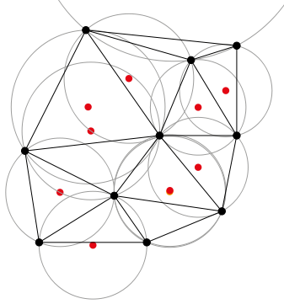
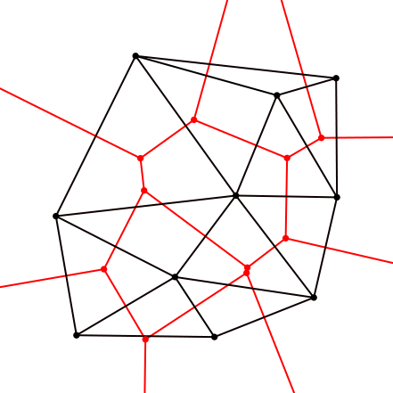
What is Delaunay Triangulation?
Efficient mesh creation between sets of vertices
Created by Russian Mathematician Boris Nikolaevich Delaunay in 1934
Centers of the resulting mesh triangle's circumscribed circles define Voronoi diagram for input vertices

Slide 3
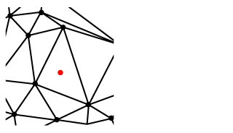
Step 1
Insert New Vertex

Slide 4
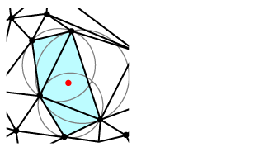
Step 2
Determine which triangles' circumscribed circles it is contained within

Slide 5
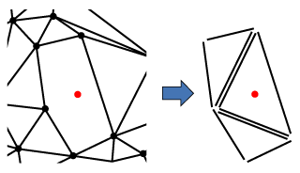
Step 3
Remove Triangles but store edges

Slide 6
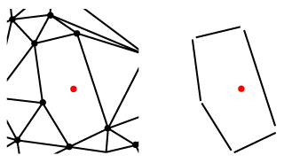
Step 4
For the stored triangles, remove double edges

Slide 7
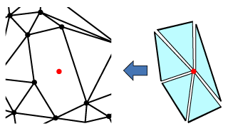
Step 5
Connect each vertex to the inserted vertex

Slide 8
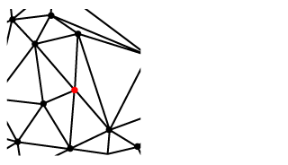
Step 6
Insert new triangles into the existing mesh

Slide 9
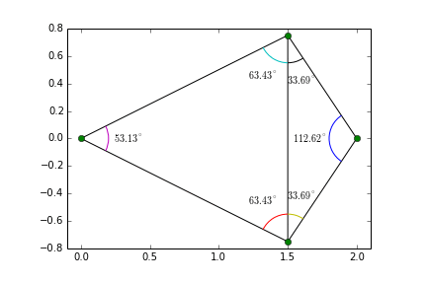
Issues
Initial setup requires either super-triangle enclosing all input vertices
  causes concave structure which can be removed
Triangulation requires “legal” triangulation
  flip edges so internal angles are minimized

Slide 10
Goals
Accept input vertices
Step through algorithm with human-readable explanations
Allow user to add vertices to completed mesh and see modifications made
Allow user to create new mesh and output as PLY model

Slide 11
References
http://www.codeguru.com/cpp/cpp/algorithms/general/article.php/c8901/Delaunay-Triangles.htm
http://en.wikipedia.org/wiki/Delaunay_triangulation
http://www.comp.nus.edu.sg/~tantc/ioi_training/CG/l10cs4235.pdf
http://mathworld.wolfram.com/DelaunayTriangulation.html
http://www.cs.uu.nl/geobook/interpolation.pdf (ch9)

